Slide 1
MID IR METASURFACE
Presentation On
By
Akshay Patil - 19353
Avinash Singh - 19273
Project Guide - Shiju Prasad

Slide 2
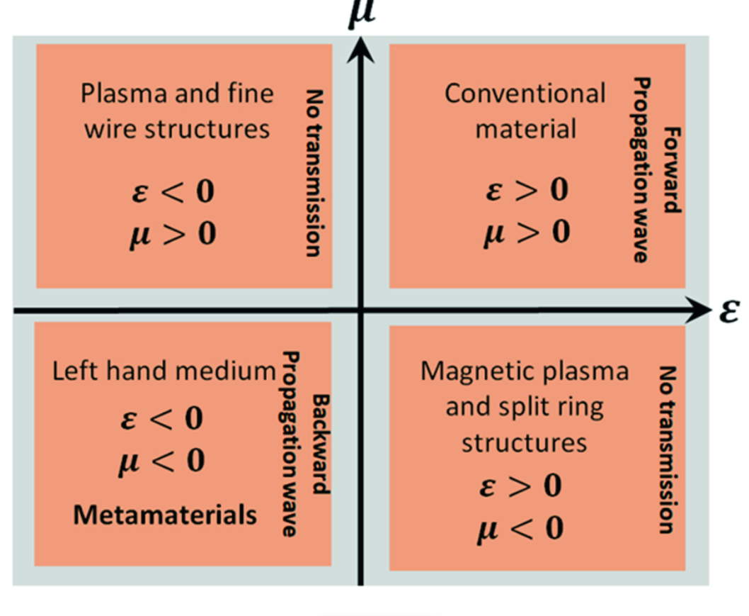
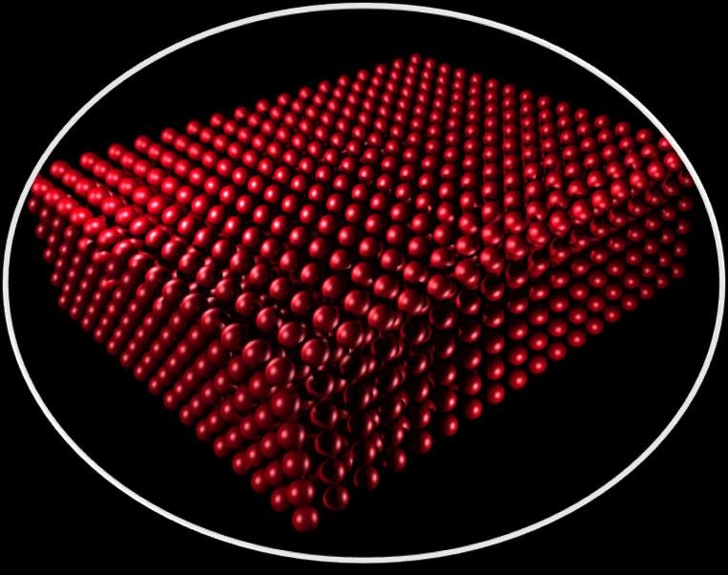
1.Metamaterial-
Any material engineered in repeating arranged patterns at scales smaller than the wavelength of electromagnetic wave i.e light, based on structures ,shape, periodicity, geometric size, orientation and arrangement makes them capable of manipulating electromagnetic waves by blocking, absorbing, enhancing or bending waves to get applications that are not possible by conventional bulk materials and means.
Fig 1. Metamaterials for negative permittivity and permeability that do not occur in conventional materials
Fig 2 Optical metamaterials

Slide 3
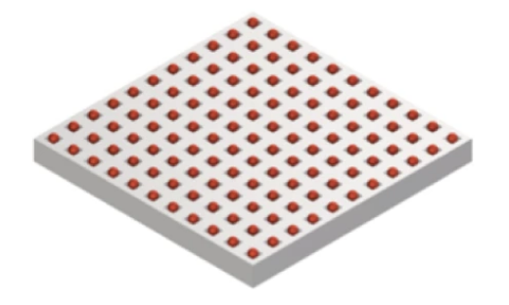
2.Metasurface-
2D counterparts of metamaterials.
Subwavelength patterned layers that interact strongly with light altering its phase and amplitude over a subwavelength thickness by manipulating the light by scattering as opposed to conventional optics which rely on light refraction and propagation.
Periodic Array of scattering elements whose dimensions and periods are small compared with the operating wavelength.
Ultrathin film on substrate without pattern can also be considered as metasurface
An antireflective coating could also regarded as a simple metasurface.
Fig 3. Metasurface – Red Particles – Selenium and Substrate PDMS

Slide 4
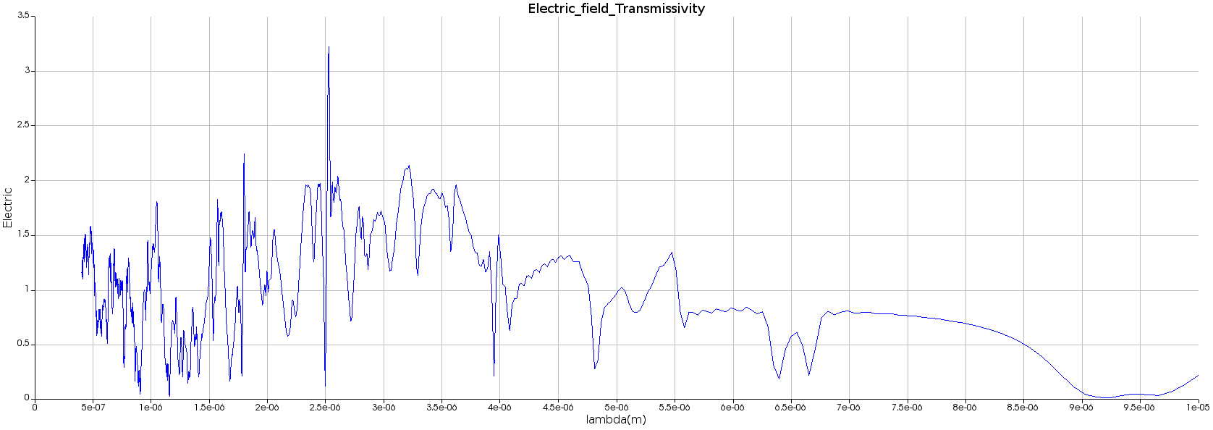
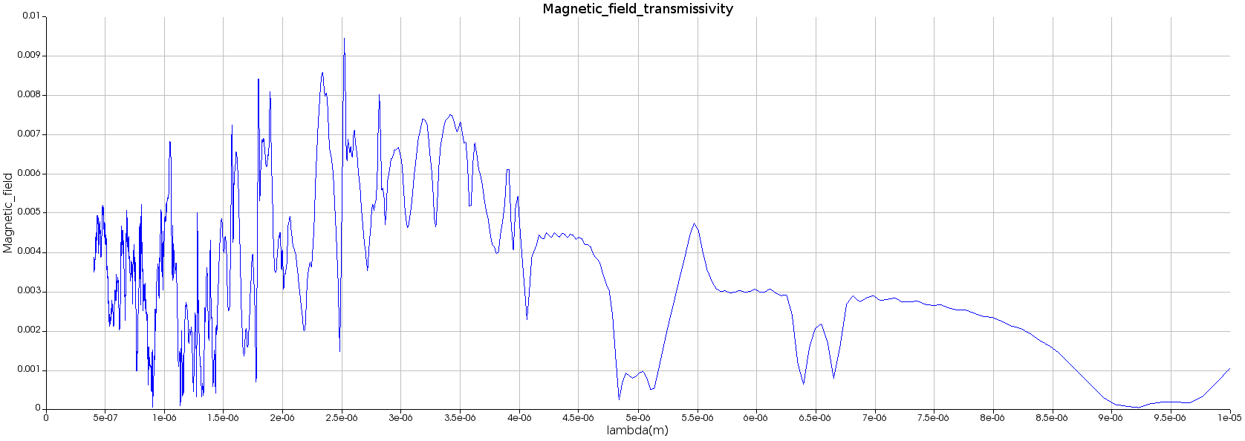
3.Fano Resonance and Mie Theory
Light being a electromagnetic wave has both electric as well as magnetic field.
When the light interacts with microscale metasurface i.e wavelength of the light is comparable to periodic array and dimensions of selenium cylindrical cavity leading to electric as well as magnetic field resonances due to aligning of electric dipoles or magnetic dipoles or both at particular wavelength and the resulting resonances is termed as Fano Resonance. i.e Reflection=1 for that particular wavelength.
Reflection from a metasurface is generally a function of complex refractive index of that surface and as extinction coefficient of PDMS (k) is not completely zero i.e there is always some absorption loss from PDMS hence the data that we obtain from theory for our metasurface structure is ideally R=1,T=0,A=0 as selenium (chalcogenide glass) has high index of refraction.
But from simulation we get R= 0.6 to 0.8 ,T=0.1 and A=0.1 to 0.3 due to absorption losses in PDMS.

Slide 5
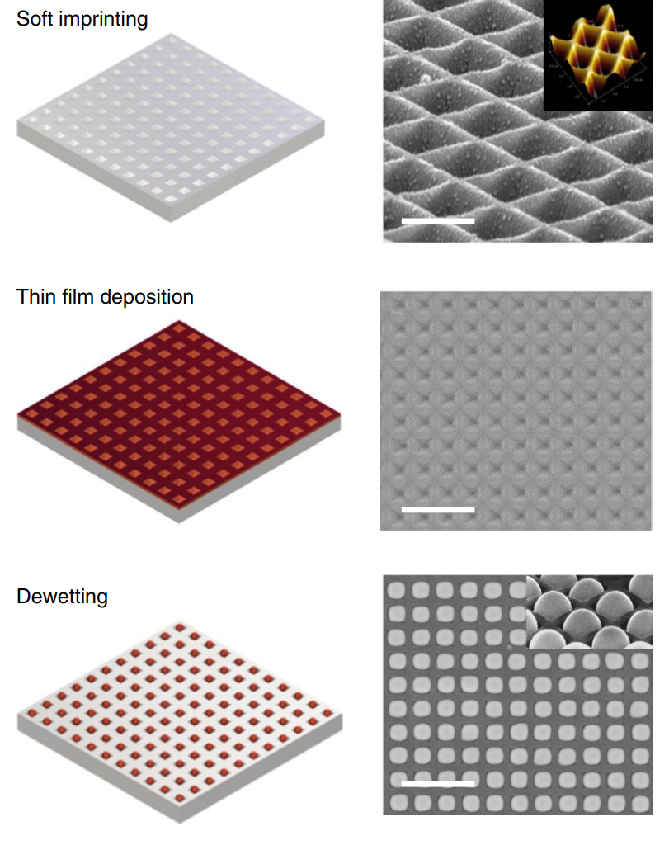
4.Fabrication Methods
Lithographic techniques – High Resolution and Repeatibillty but are complex to apply on large area and scale to non rigid i.e stretchable substrates.
Lasing Printing or chemical or Self Assemblly Methods.
Topological control of Particle position
DNA assisted Templates
With above 3 methods its difficult to construct complex shapes of waveguides and resonators for Integrated Photonic circuits and not suited for soft substrates such as PDMS which is required for dynamic tuning of optical properties of metasurfaces via stretching.
Therefore we use the fabrication method of controlled dewetting of Selenium (due to ability of selenium to flow in their glassy state) on PDMS substrate to realize metasurfaces over large area and soft substrates (PDMS)
Fig 5.Array creation on PDMS by Deep coating followed by Thermal Evaporation of Se on PDMS followed by dewetting of Se on PDMS substrate

Slide 6
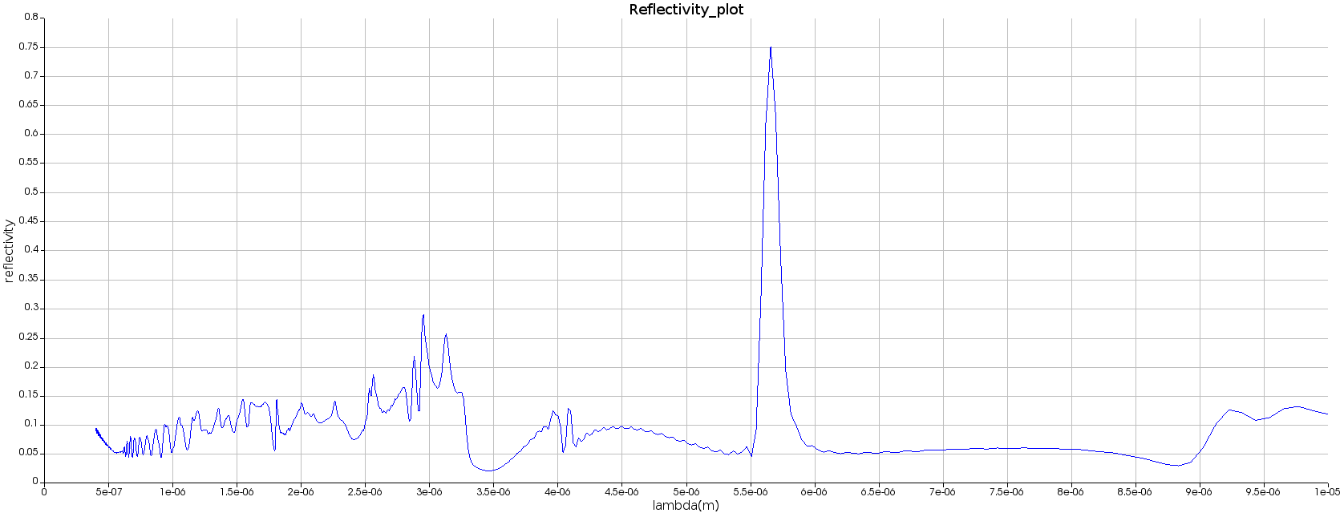
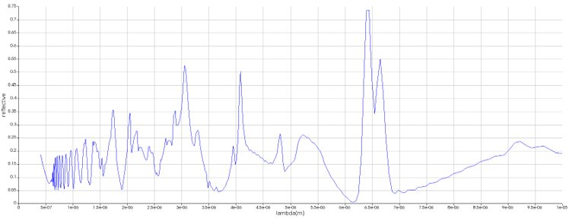
5.Effect of change of Periodicity, Cavity, Shape and Size change on the optical response and dewetting (from lumerical simulation)
Plot 1. Reflectivity vs Wavelength for
Period = 3.9 μm
Diameter = 2μm
Optimum Height = 1.555μm
Plot 2. Reflectivity vs Wavelength for
Optimum height =1.555 μm
Diameter = 3.6 μm Period = 3.9 μm

Slide 7
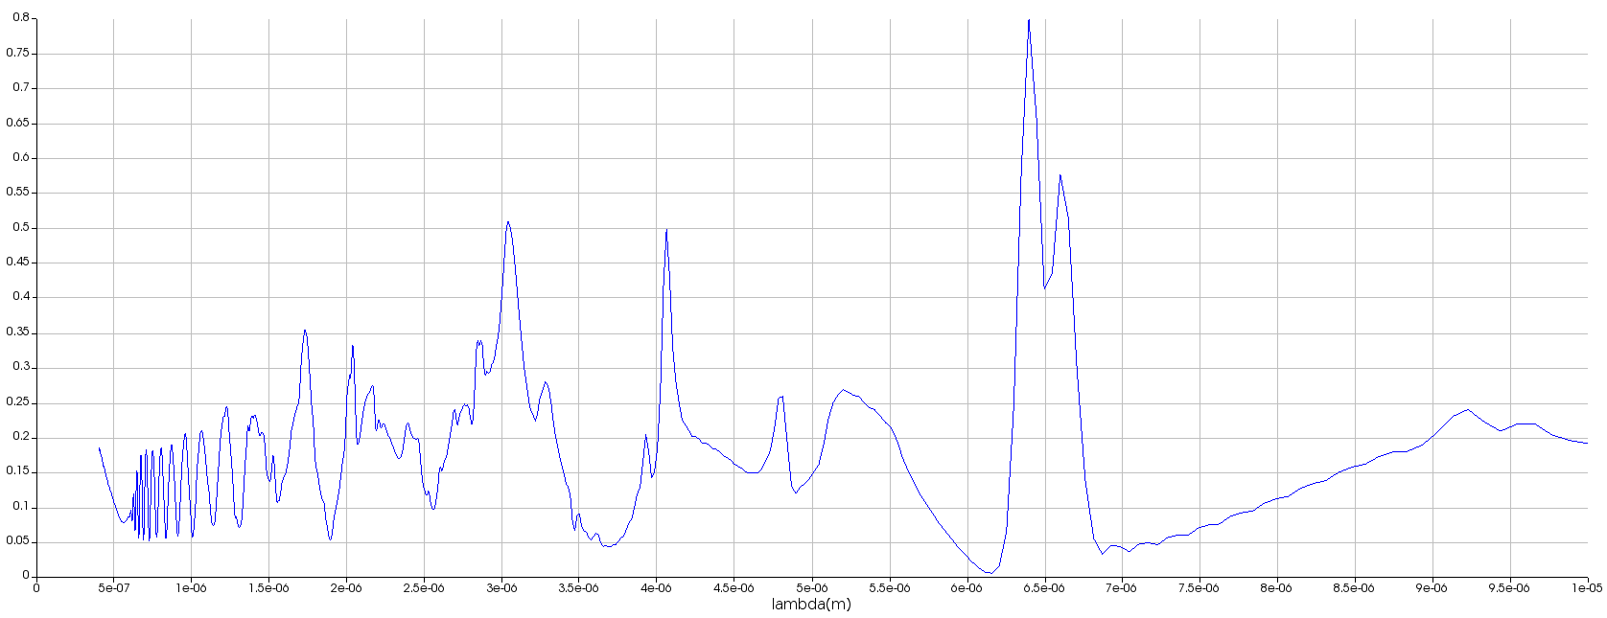
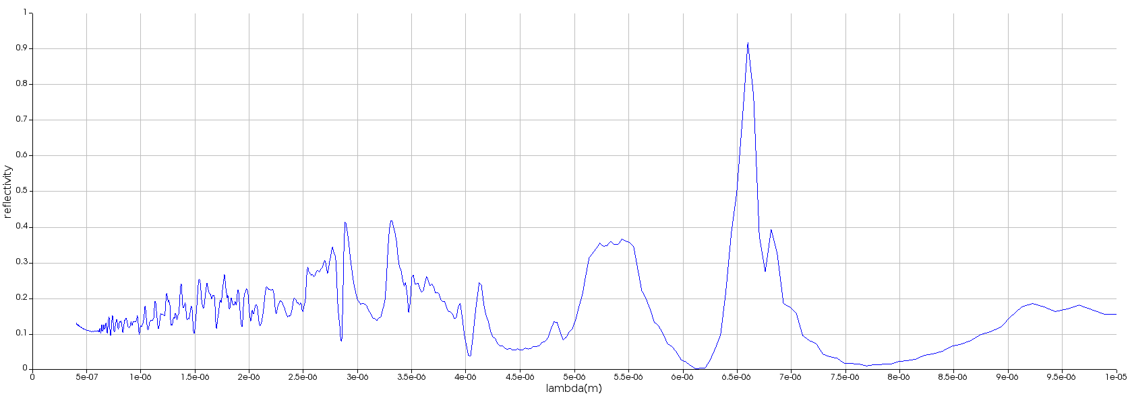
Plot 3 . Reflectivity vs Wavelength for
Optimum height =1.555 μm
Optimum Diameter = 3.6 μm
Optimum Period = 4 μm
Plot 4. Reflectivity vs Wavelength for shape change from flat surface to hemispherical surface

Slide 8
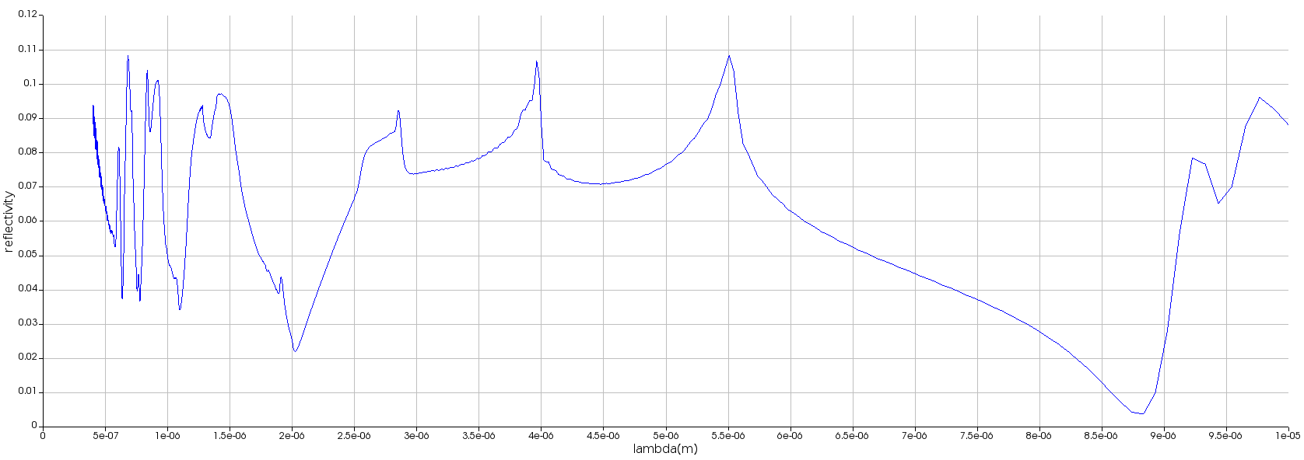
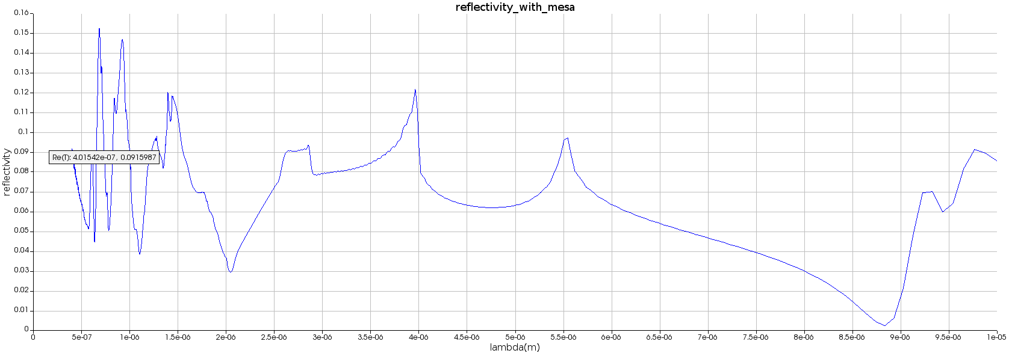
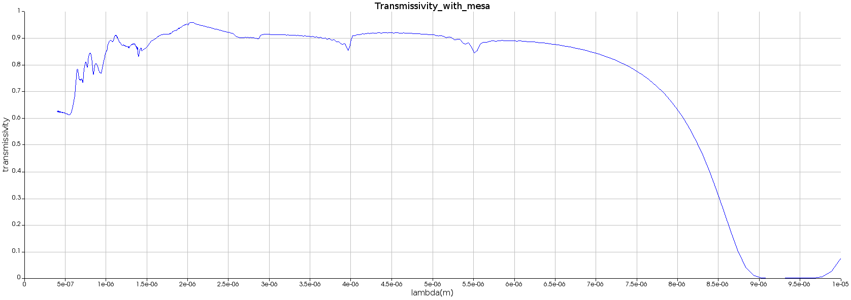
6.Lumerical Simulation Results
Plot 1.Reflectivity plot for full filling of holes and no mesa particles 400nm,1μm radius cavity,period = 4 μm
Plot 2.Transmittivity plot for full filling of holes and no mesa particles 400nm,1μm radius cavity,period = 4 μm
Plot 3.Reflectivity plot for full filling of holes and spherical mesa particles 400nm,1μm radius cavity,period = 4 μm
Plot 4.Transmittivity plot for full filling of holes and spherical mesa particles 400nm,1μm radius cavity,period = 4 μm

Slide 9
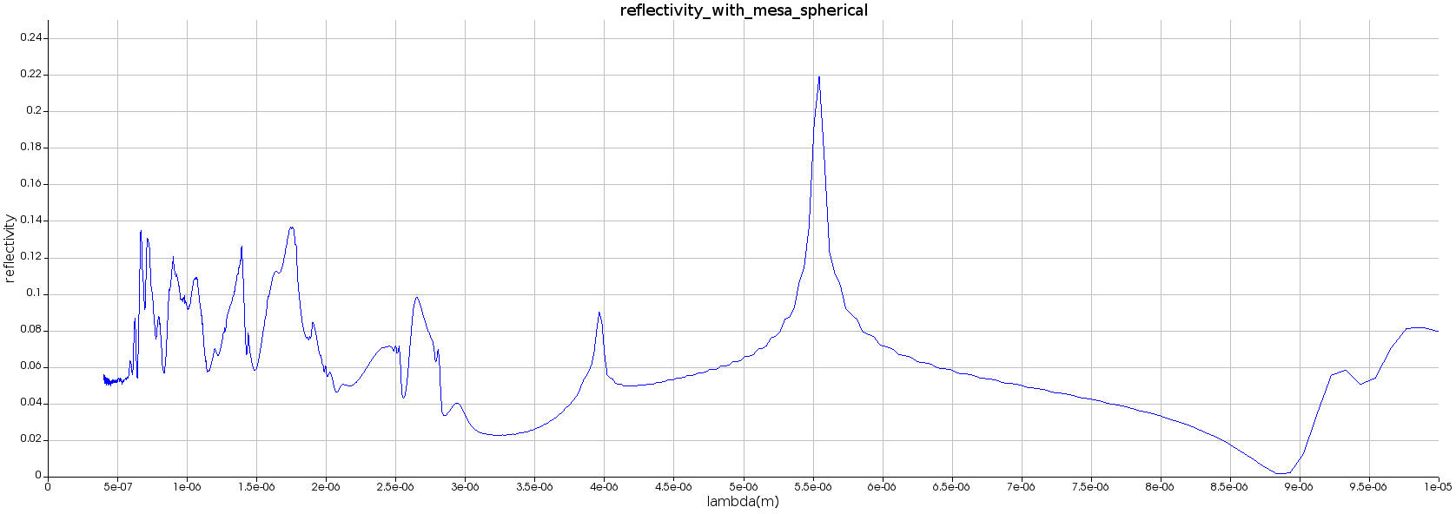
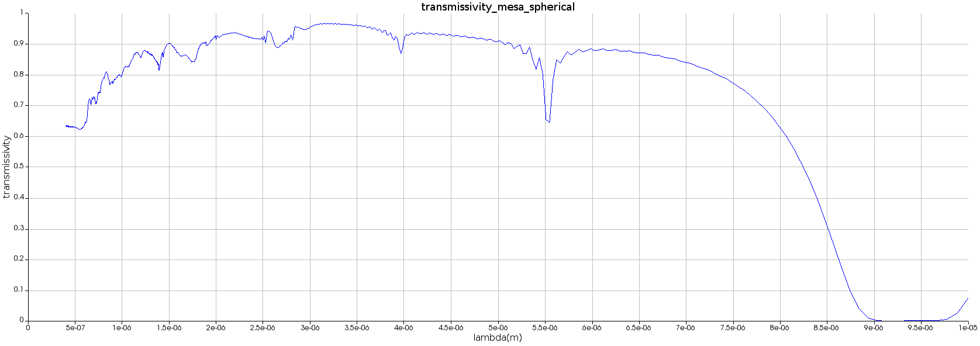
Plot 5.Reflectivity plot for full hemi - spherical surface filling of holes and spherical mesa particles 400nm,1μm radius cavity,period = 4 μm
Plot 6.Transmitivity plot for full hemi - spherical surface filling of holes and spherical mesa particles 400nm,1μm radius cavity,period = 4 μm

Slide 10

7.Theory of Physics of Parameters – Thickness of Selenium, Time and Temperature of Dewetting
Navier’s Stokes Theory –
1.By solving Navier Stokes equation but taking into account laplace pressure, disjoining pressure and considering selenium as Newtonian fluid we get the sinusoidal time scale as ,
$τ$_{sp} =$\frac{3η}{γ Km4ho3 }$
_{where} $=Dynamic Viscosity −Ns/m2$
$ =Surface Tension of Selenium Bubble −N/m$
$ho=Initial Film thickness$ of selenium $−$ m
k_{m} $=$ Wave Number $=$2$π/$_{m}
where $$_{m} $−Wavelength that grows fastest under some perturbation(heat source in our case)$
_{2.} $τ$_{sp} is the sinusoidal time scale i.e a time scale which can be found experimentally by using video recording of live dewetting of the Selenium on plain substrate of PDMS and $τ$_{sp} α $$_{m}^{4.} . It is basically the separation of the continuous selenium film into separate bubble or particles.
3.$τ$_{R} is the reflow time =$\frac{3η}{γ K4ho3 }$ , it is the time required for Se in its glass state to reflow into cavity or template.

Slide 11
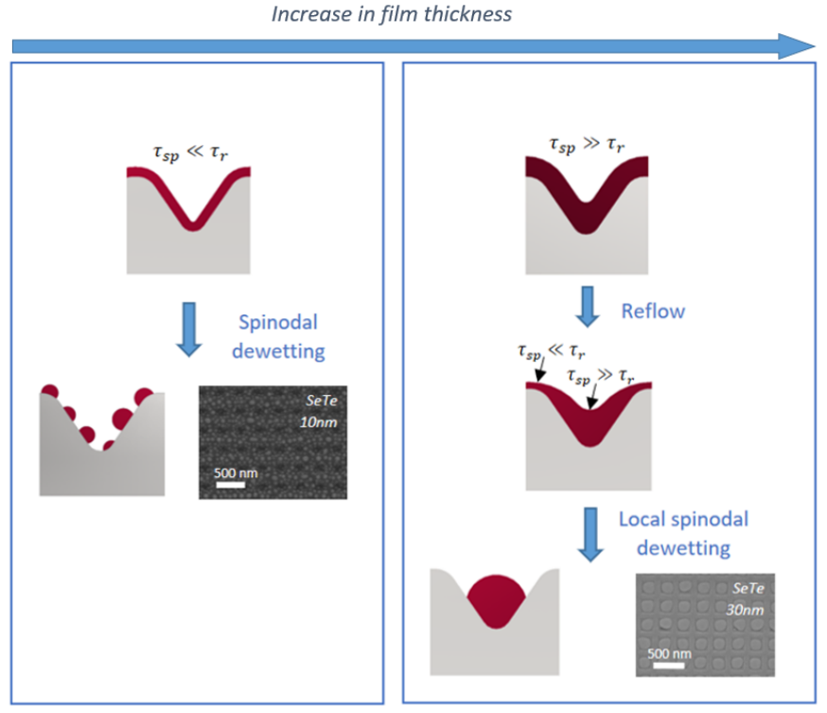

4. 1. 3 possible cases –
$τ$_{R} > $τ$_{sp} → Sinusoidal instability dominates → flow becomes unstable after heating but before reflow in template it separates into bubbles.
$τ$_{R} < $τ$_{sp} →Reflow dominates → flow becomes unstable after heating and reflow takes into template before separation of the particles. → Desired Case.
$τ$_{R} = $τ$_{sp} → Reflow dominates but still pre-separation occurs at some places before reflow so better to go for case 2.
2.By increasing initial thickness we can make $τ$_{R} < < $τ$_{sp} hence we took h_{o} = 400 nm even if the h_{omin} = 75nm by volume conservation.
3. $τ$_{sp} decreases with the thinning of the deposited glass layer.
4. Hence time scale of dewetting can be tuned by initial thickness deposited.
5. But large thickness means large mesa particles after dewetting which we observed in the 400nm samples.
6. For higher thickness above a certain thickness both the reflow and Rayleigh Taylor instabilities decrease and the final structure no longer flow in the underlying pattern and form particles sitting in between grooves which we observed in 600 nm sample
Fig 6. As we increase film thickness we go from Sinusoidal Instability Dominated Zone to Reflow dominated Zone

Slide 12
8. Experimental Procedure
A.Two step process of making of Silicon mould
1.Photolithography : Determines the diameter, period of the cavity.
2.Reactive ion etching: determine height of the pillar (hole).
B.PDMS substrate creation
Mixing PDMS to curing agent (10:1)
To remove air bubbles we put sample in vacuum via desiccator
Blowing away dust particle from Silicon wafer using N₂ gas
Pour PDMS above Si substrate in petri dish
Again put the petri dish in desiccator to remover bubbles
Now place dish in oven at 80⁰ C for curing
After 3 to 4 hour separate the PDMS from silicon wafer
Once PDMS with arrayed cavity is created we go for thermal evaporator of selenium over arrayed PDMS in evaporator
Once the film of Se is deposited on PDMS we first check the Structure under microscope just to verify whether the film is disposited uniformly on substrate.
After that we place metasurface on hot plates annealing for desired time and temperature to achieve dewetting.
Once we get good result we perform FTIR on sample to get optical properties.

Slide 13
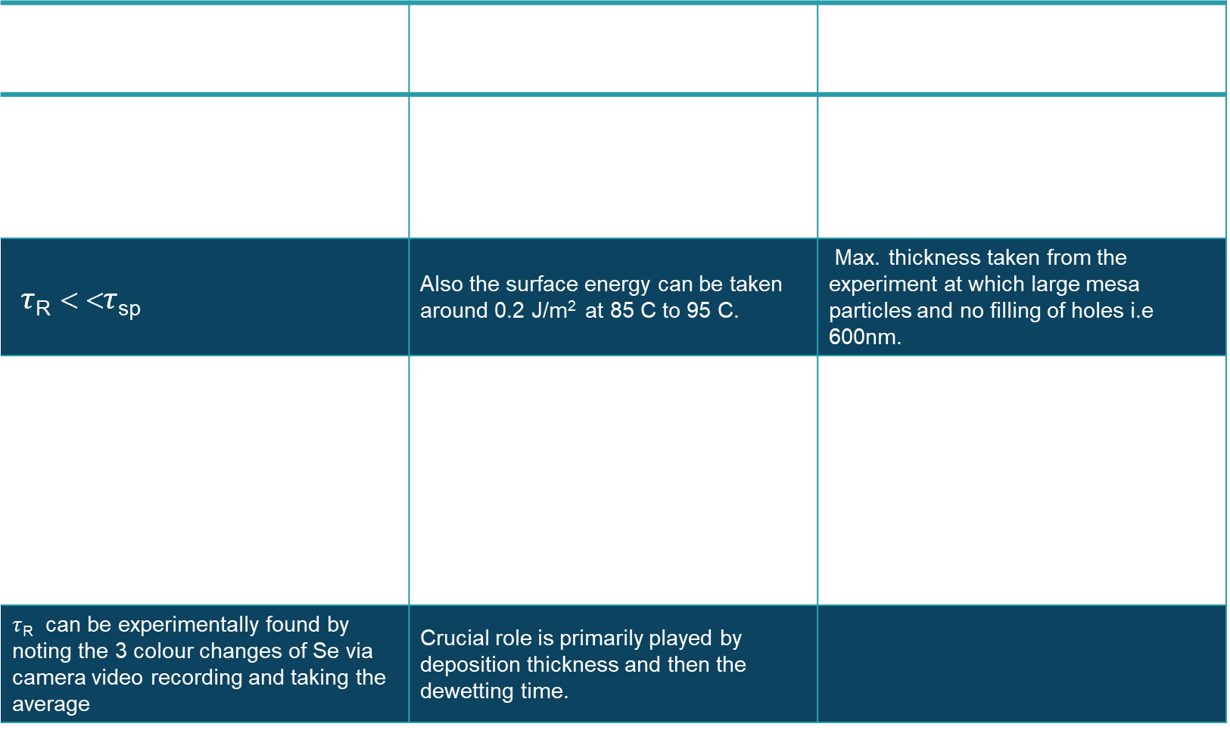
9.Theoretical Conclusion of Parameters
Time of Dewetting | Temperature of Dewetting | Thickness of Deposition
1.Reflow Time ($τ$_{R} ) 2.Reynold/Sinosoidal Instability Time($τ$_{sp} ) | Viscosity of Se and surface energy of Se is dependent (both decreases with temperature) on temperature but at 85 C to 95 C viscosity can be taken as 10⁴ to 10⁵ Pa-s. | Minimum thickness is taken from volume conservation theory i.e. 78.5 nm
$τ$_{R} < <$τ$_{sp} | Also the surface energy can be taken around 0.2 J/m² at 85 C to 95 C. | Max. thickness taken from the experiment at which large mesa particles and no filling of holes i.e 600nm.
Theoritically obtained from Navier Stokes Model and depends on 1.Viscosity of Selenium at temperature of dewetting 2.Thickness of Deposition 3.Wave No. (Periodic Lattice) 4.Surface Tension of Se of glass air interface | From experimental observation temperature from 85 C to 95 C dewetting doesn’t play a crucial role. | So for conclusion the optimum thickness for our period and array lies in between 78.5 nm to 600nm.
$τ$_{R} can be experimentally found by noting the 3 colour changes of Se via camera video recording and taking the average | Crucial role is primarily played by deposition thickness and then the dewetting time.

Slide 14
10.Experimental Conclusion Of Parameters
1.Annealing of PDMS Se Array at temperature above 35 C which is the glass transition temperature of Se i.e after this temperature Se in glassy state flows in the patterned arrays of PDMS and we get arrayed filled metasurface.
2.Time of Annealing as well as temperature of annealing are crucial parameters for achieving completely filled metasurfaces of Se in PDMS.
3.As there is no exact physics till date giving exact values of the time and temperature theoretically,we have to rely on experimental trial and error for getting time and temperature.
4.Volume Conservation Theory –
By volume conservation theory → p² *t = Π/4d² *h
t = 0.785 d² *h /p²
For our Metasurface p = 4 μm , d = 2 μm , h = 0.4 μm
we get ,t_{min} = 78.5 nm = h_{omin}
5.From theory we tried 1. t = 400nm at deposition rate of 2 A/s
2. t = 600 nm at deposition rate of 2 A/s
and experimental results we got after delta dewetting for a temperature range from 85 C to 95 C for a time range of 30 sec to 5 min intervals we found that all 600 nm thickness samples gave poor results i.e either half filling or no filling of holes and large mesa particles so we decided that 600 nm is the maximum critical thickness beyond which Se does not flow in the template

Slide 15
6.We found satisfactory results for 90 C and 3 min,85 C and 3 min and 95 C 3 min for 400 nm so we decided to do successive evaporation and dewetting of these sample @ t = 150 nm @ deposition rate of 0.1 A/s and for 85 C 1 min as well as 90 C and 95 C 1 min.
7.We found complete filling of holes but the only barrier to call it 100 % ideal was formation of large and small mesa particles.We tried scotch taping the samples to remove the large mesa particles but since it depends on the user we cant quantify the pressure and we decided to scrap the process altogether.
8.We again did successive evaporation at 100 nm ,1 A/s but to our surprise we saw complete filling of holes , and also we saw large mesa particles and smallmesa particles and red film due to large collective thickness of Selenium on the PDMS.
9.So now what worked for us was t = 400 nm, 2 A/s so we decided to proceed with it for evaporation and dewetted with
85 C,90 C , 95 C 1 min to 5 min and to our surprise all the samples except for time greater than 3 min gave us consistent full filling of holes with large mesa particles.
10.Also PDMS thickness of this new sample was very less compared to previous sample which can play some role in heat transfer ( thermal conductivity of PDMS is 0.15 W/mk) and finally in dewetting parameters.But the problem with having low thickness of PDMS is we cant identify which side contains array, we tried with the Compton tape but it cause another problem of non uniform touching of PDMS on hot plate and also gave us difficulties for getting clear image from microscope as plane become different for small intervals.
11.Why we were getting large mesa particles-
1.It was due to the fact that period was too large and cylindrical cavity radius too small for the selenium to flow in the cavity and cause no formation of mesa particles due to spinoidal instability
2.Also the thickness 400 nm was quite high by volume conservation theory so more extra Se remain even after complete filling of cavity.

Slide 16
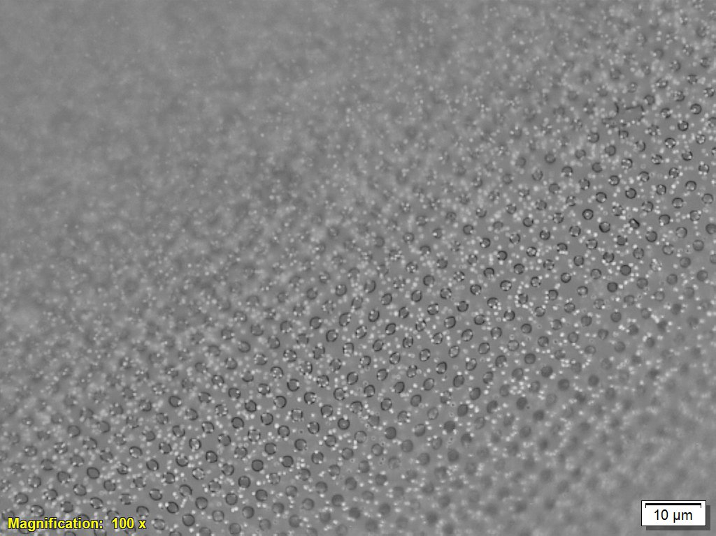
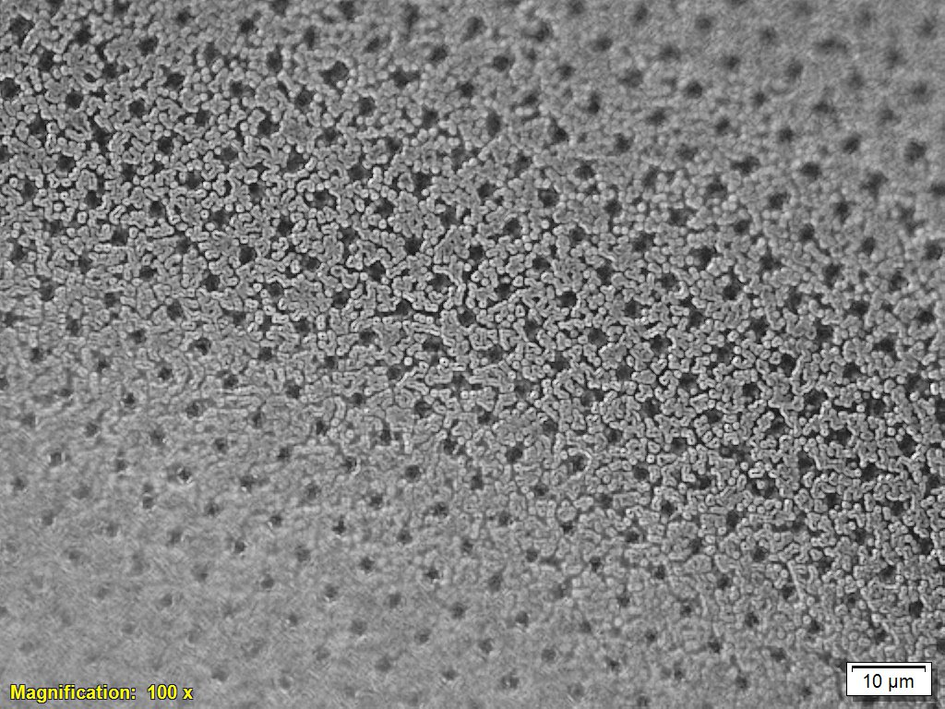
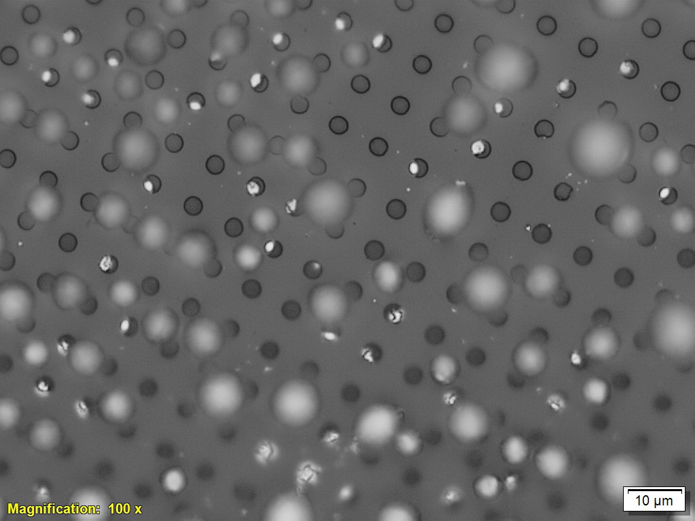
12. To solve these above problems we decided to do thermal evaporation of Se 120 nm @ 0.1 A/s on arrayed PDMS but to our surprise due to low rate of deposition and high temperature of evaporator @ around 35 C the selenium already got dewetted on 200 nm and 2 A/s as next trial which according to previous data should optimal results but unfortunately due to failing of chiller we were unable to do any further evaporation till due date. Hopefully we will continue this work in the future as well.
13.Also we can vary the period as well the cylindrical cavity dimensions to get reflectivity near equal to 1 as we saw in the lumerical simulation as well as little to no mesa formation.
14.The dimensions of period = 4 μm and spacing are the maximum lower limits of the photolithography tool available at cense we can’t go below this dimension. Electron beam lithography was an available option but we can pattern only upto 2 mm² area and its very slow process.
15.Experimental Microscopic Images of Metasurface after Dewetting
Fig 1 .40 nm initial thickness
Sinosoidal Flow Instability Dominates and dewetted already in evaporator
Fig 2. 150 nm initial thickness for 0.1 A/s deposition rate again Sinosoidal Flow Instability Dominates and dewetted already in evaporator
Fig 3. 600 nm initial thickness dewetted at 90 C delta for 7 min – No filling of holes and large mesa particles

Slide 17
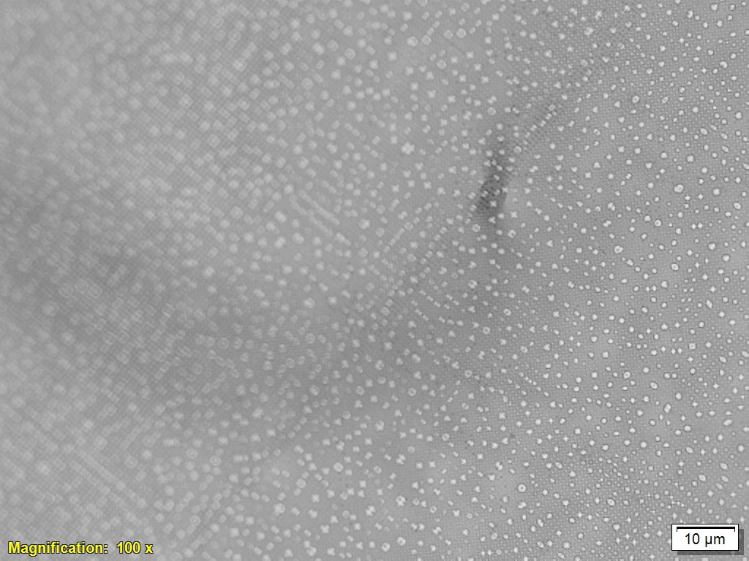
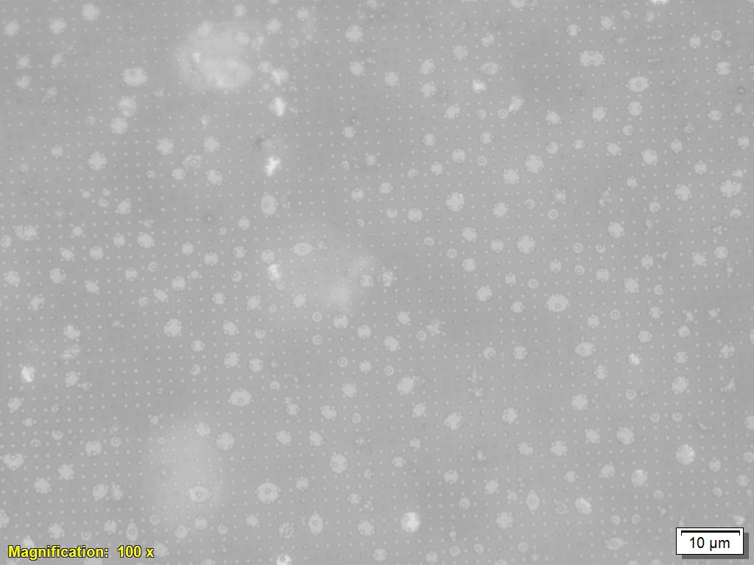
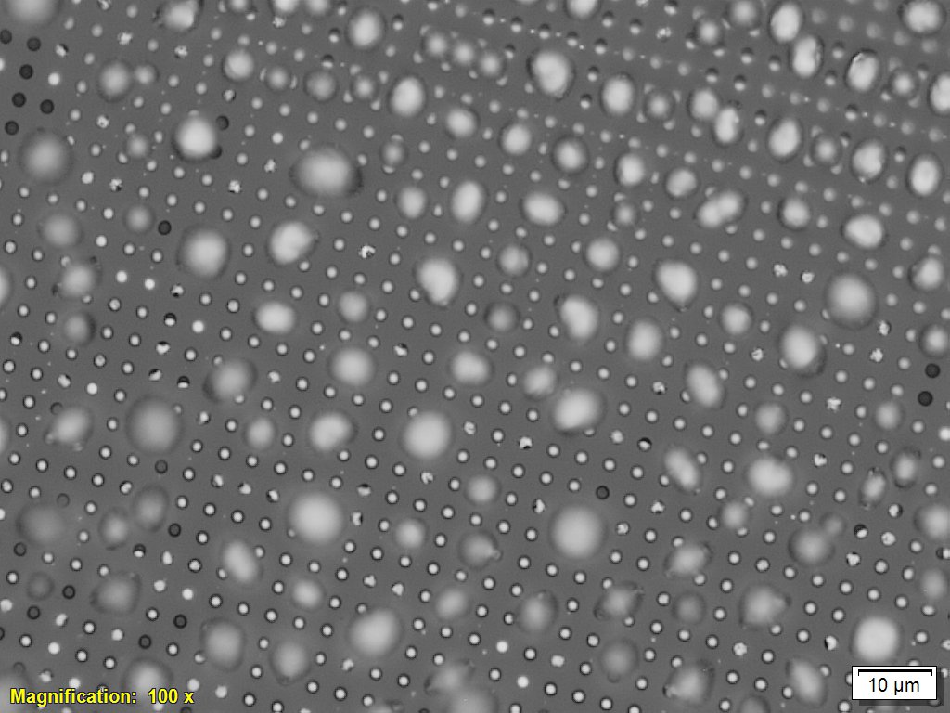
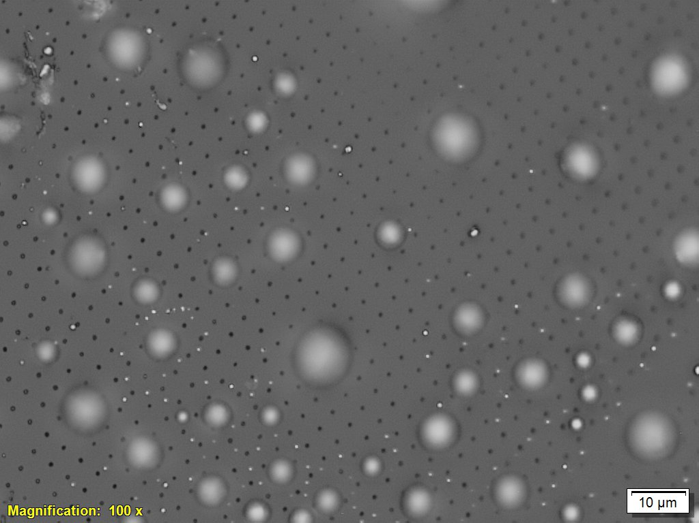
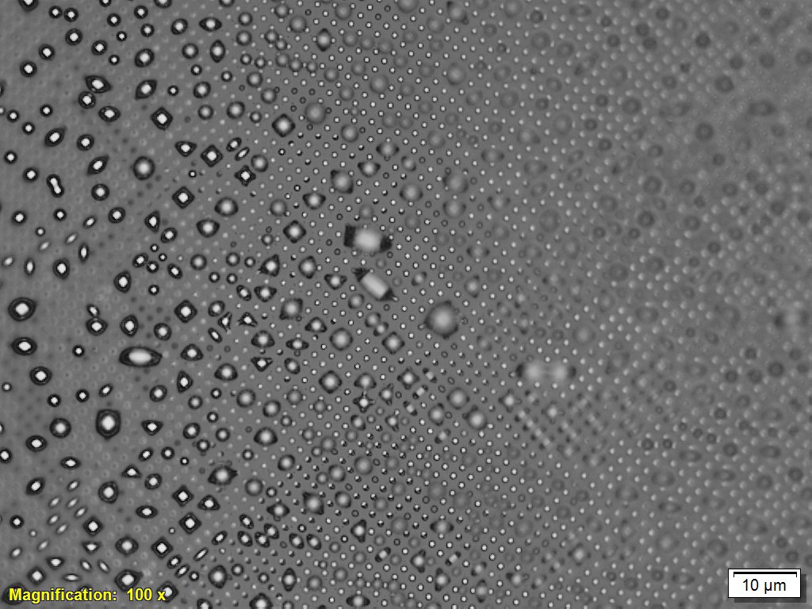
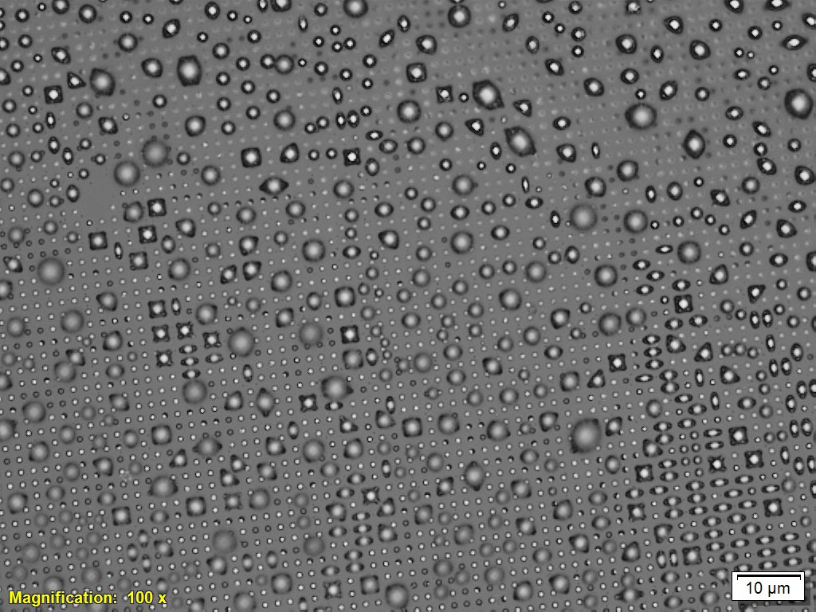
Fig 4. 400 nm,85 C , 30 sec - Best Sample – Complete Filling of Holes but large mesa
Fig 5. 400 nm ,85 C ,1.5 min – still consistent and complete filling of holes but large mesa
Fig 6. 400 nm ,85 C ,3.5 min – still consistent and complete filling of holes but large mesa
Fig 7. 400 nm ,85 C ,5 min – No filling of Holes and large mesa
Fig 8. 400 nm ,90 C ,2min – filling of Holes and large mesa
Fig 9. 400 nm ,95 C ,1 min – filling of Holes and large mesa

Slide 18
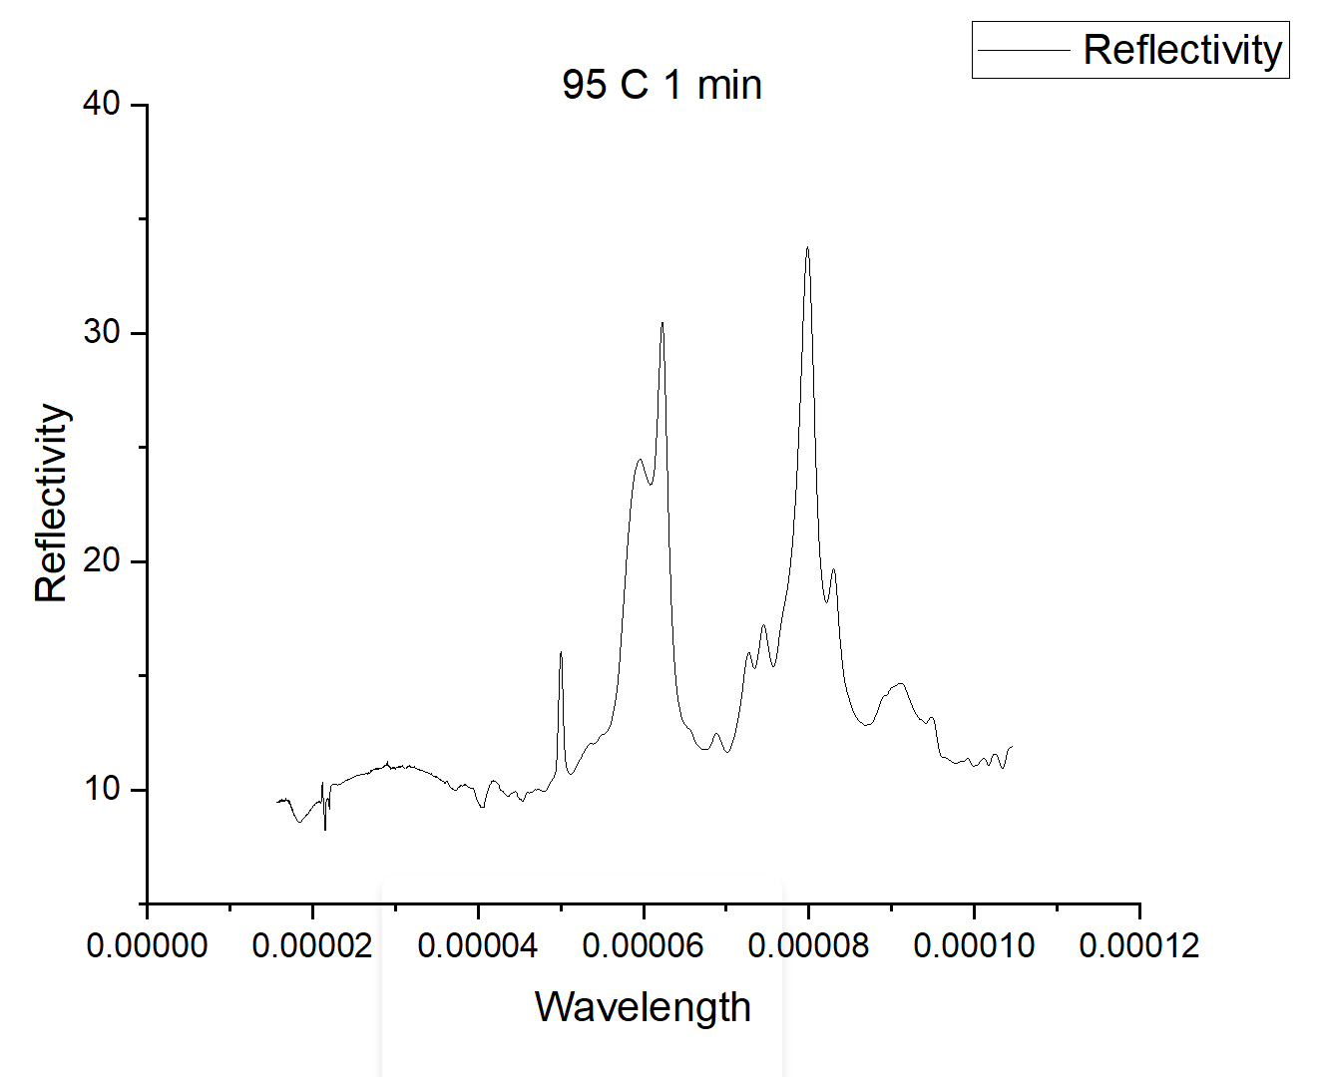
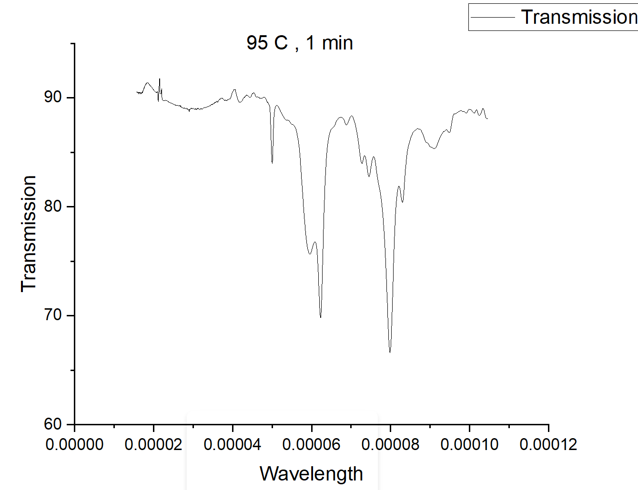
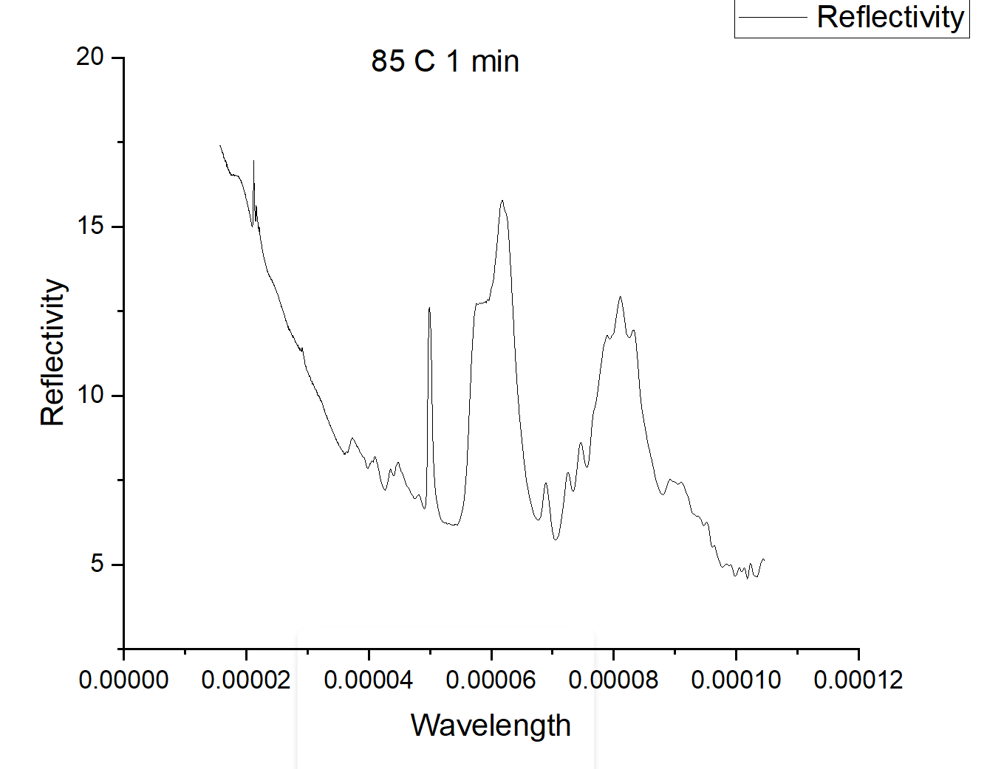
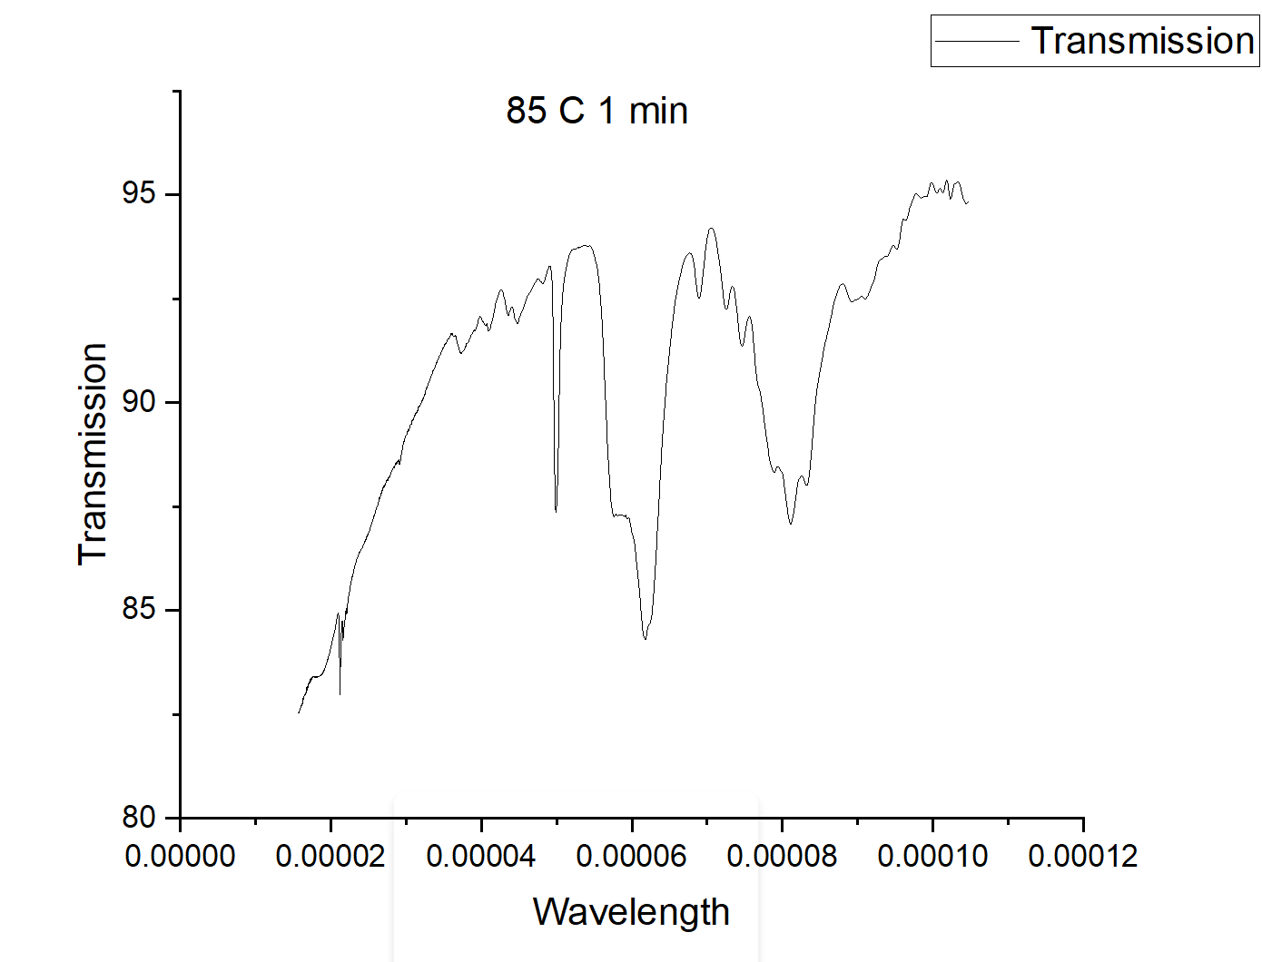
11.Experimental Optical Results (FTIR)
Plot 1. FTIR Reflectivity plot of fully filled hole sample having large mesa (single evaporation and dewetting)
Plot 2. FTIR Transmittivity plot of fully filled hole sample having large mesa
Plot 3. FTIR Reflectivity plot of fully filled hole sample having large mesa and small mesa (successive evaporation and dewetting) – best hole filling
Plot 4. FTIR Transmittivity plot of fully filled hole sample having large mesa and small mesa (successive evaporation and dewetting)

Slide 19
12.Comparison of Theoretical (Numerical) and Experimental Results
1.Reflectivity is always 0 to 0.3 for the mid IR wavelength range as observed both in the lumerical simulation as well as experiment due to the fact that our cavity size of the array is not optimum to get near 1 reflectivity.
2.Even if the range of values match there is always deviation between the simulated and the experimental results from above as we are assuming periodic perfect uniform repeatition of mesa particles but in practice mesa particles are not uniform and also all the holes of the metasurfaces may not be completely filled due to some defects.

Slide 20
13.Future Prospects
Developing Accurate theory of physics from Navier Stokes equation for cylindrical cavities.
Simulating the Navier Stokes Physics in COMSOL to accurately get the dewetting parameters as well as the deposition thickness from COMSOL itself.
Exploring Metasurfaces for the application of ‘invisible cloaking’ in the optical wavelength range.
Trying different substrates as well as straining the substrates to see for the wavelength peak shifts and optical properties.
14.Applications Of Metasurfaces
1.Metalenses
2.Metaholograms
3.Generation, Manipulation and detection of light for quantum technologies
4.Polarization control Optics.
5.Active Metasurfaces.
6.Reconfigurable Optical Metasurfaces.
7.Quantum Metasurfaces

Slide 21
8. Emitting and Lasing Metasurfaces.
9. Wavefront Shaping
10.Photonics and Biosensing
11.Invisibilty Cloaking
12.Superposition Imaging
13.Efficient Energy Harvesting
14.Mid IR Filters
15.Quantum Sensing

Slide 22
References
Das Gupta, T., Martin-Monier, L., Yan, W. et al. Self-assembly of nanostructured glass metasurfaces via templated fluid instabilities. Nat. Nanotechnol. 14, 320–327 (2019).
Vin-Cent Su, Cheng Hung Chu, Greg Sun, and Din Ping Tsai. et al. Advances in optical metasurfaces: fabrication and applications
Optical metasurfaces: new generation building blocks for multi-functional optics Dragomir Neshev & Igor Aharonovich
The Fano resonance in plasmonic nanostructures and metamaterials by Boris Luk'yanchuk
Electromagnetic metasurface – Wikipedia

Slide 23
Thank You

